Slide 1

Introducing
2 in 3 young people have not started investing
(The Straits Times, 2016)
Why?
Key reason: lack of financial knowledge
finance.io

Slide 2

Introduction
Web app that educates students on financial planning
Helps determine the amount of money to save, spend, and invest
10-15% of your money should be invested
10-15% of your money should go into savings
50% of your money is for essentials (food, water, rent, etc.)
Shows real-time stock information and presents it as a graph

Slide 3
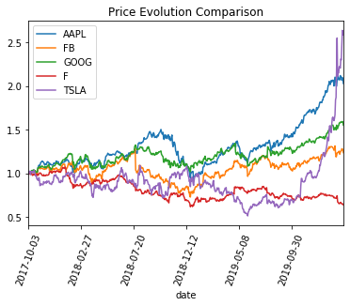
Introduction
Website includes guides, external links, and references
Users have a personal account to keep a record of their money use
Stock data visualisations help users choose their investments wisely

Slide 4
Business case
Low cost of implementation for f.io, therefore can remain free for users
Simple website with easy access - users can update their monthly income to determine how best to use their money
Cloud deployment saves costs with their services scaling to meet f.io’s needs. Allows for scalability and future growth
Having one place to check everything - personal savings, spendings, and investments, as well as lessons and how-to guides
Additional revenue:
Premium user subscriptions
Sponsorship/ads from other financial services, blogs, etc.
Partnerships with learning platforms

Slide 5
Business case
Target market:
Students, fresh graduates
Singapore, future expansion in ASEAN region
Potential partners/affiliate marketing:
Learning platforms:
Khan Academy
Coursera
FutureLearn
Financial planning advice:
thebalance.com
beyondyourhammock.com
thecollegeinvestor.com
Social impact:
Reduce the amount of debt among the younger generation
Encourage wise spending, saving, and investing

Slide 6
Solution architecture
Front-end:
HTML, CSS, Jinja2 (later removed as it did not show up on AWS s3 website)
AWS services:
Cloud9 IDE
S3 for static web hosting
CloudFront to improve speed (site went down after a day)
Back-end:
Python Flask
SQLite Database using SQLAlchemy
Yahoo Finance API to obtain stock data

Slide 7
Future improvements
Format:
Create a mobile app version
Front-end:
Complete webpages
AWS services:
Fix the CloudFront site
Host using EC2
Implement DynamoDB
Use Amazon Sagemaker to run Machine Learning algorithms on the stock data to create predictions to help users better invest
Back-end:
Proper and complete implementation of SQLite Database using SQLAlchemy
Integrating data from Yahoo Finance API to create graphs that can be updated real-time on the website
If only we could code better...

Slide 8
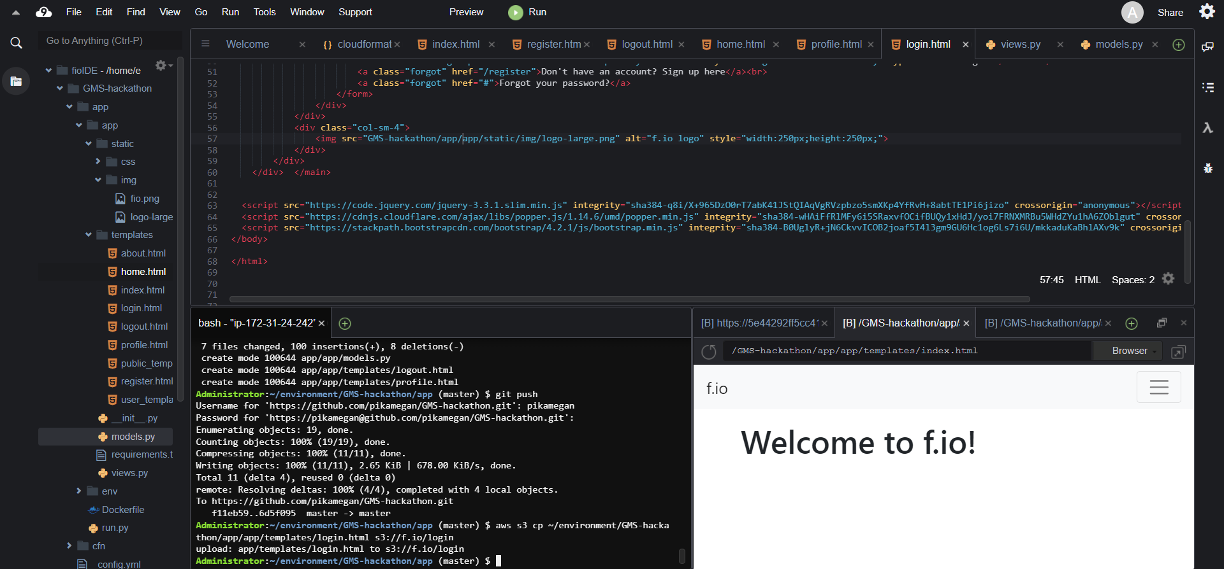
Cloud9 IDE

